Slide 1
Adaptive Trial Designs
Lessons learned in oncology at AstraZeneca
Andy Stone
TA Statistical Expert Oncology
PSI 2012
See also:
Pharmaceutical Statistics 2014 13: 229-237
J Clin Oncol 30:3588-3595
E: andrew@stonebiostatistics.com
T: +44 (0) 7919 211836
W: www.stonebiostatistics.com

Slide 2
Overview
Summary of design
What actually happened
What can we learn?

Slide 3
The Development Programme

Slide 4
Some Context
Bevacizumab, a monoclonal antibody against VEGF, demonstrated an unprecedented improvement in overall survival (HR= 0.66, 5 month) in 2004 in 1st-line colorectal-cancer (CRC) in combination with chemotherapy
In 2005 AstraZeneca also had a small molecule, cediranib, inhibitor of VEGF in Phase I development
Pre-clinically highly potent
Activity against additional VEGF receptors believed could lead to differentiation
Encouraging phase I data showing dose response in tumour shrinkage, as monotherapy, in a randomised phase I study
Great excitement within the company
A similar agent, vatalanib, had also recently completed pivotal trials in colorectal in combo with chemo in comparison to placebo
PFS HR=0.88, p=0.12
Pre-clinical data showed cediranib to be more potent and, unlike vatalanib, no PK issues
It was decided the product would only be valuable if it could be differentiated and show value over the new standard of care and the development would need to be rapid to be first to market
Decision made, in full knowledge of the required efficacy threshold, to proceed straight to PIII

Slide 5
Considerations for a development programme
How to mitigate lack of PII data?
Lack of randomised combination data concerning the activity of cediranib
Uncertainty concerning appropriate dose
Endpoint likely to be most sensitive was Progression Free Survival (PFS) and relatively long duration (median=9m) of any PII trial
We decided to:
Design the trial to assess for non-inferiority i.e. large trial
Embed a PII trial within a PIII trial which would allow:
Development to be stopped if insufficient activity
Drop one of the doses if we continued
PII patients to be included in PIII
Perform a separate randomised PII, with the same treatment arms, to provide a faster PFS read out & feed into the PII decision
Perform a second pivotal trial against placebo on a background of chemotherapy to support non-inferiority
We had designed an Adaptive Trial design and recognised the issues
But did not know it would be called that at the time!

Slide 6
Overview of programme
2nd-line PII trial
Placebo PIII trial
PhII 2nd line CRC (67pts/arm) 2 doses vs bevacizumab
PhII run-in 1st line CRC (75 pts/arm) 2 doses vs bevacizumab
PIII 1st line CRC (350 pts per arm) 2 doses vs placebo
Continue recruitment, whilst follow for RR ~300 additoinal pts
PFS Efficacy Data
Tolerability & RR Info
GO/NO GO
1Q08
Ph III 1st line CRC: 1 dose vs bevacizumab. Recruit until total 1400 patients in selected arms

Slide 7
Adaptive study design
Phase II
N=225
GO/NO GO
Phase III
N=1422 including patients from Phase II
R
a
n
d
o
m
i
z
e
mFOLFOX6 +
cediranib 30 mg
R
a
n
d
o
m
i
z
e
mFOLFOX6 +
cediranib 20 mg
Dose
selection
1:1:1
mFOLFOX6 +
cediranib 20 mg
1:1
mFOLFOX6 + bevacizumab 5 mg/kg
mFOLFOX6 + bevacizumab 5 mg/kg
1° endpoint: PFS – non-inferiority if superiority not achieved
90% power for superiority if true HR =0.8, including PII patients from selected arms
Non-inferiority achieved if upper 2-sided 95% C.L < 1.2
2° endpoints: OS, ORR, DoR, QoL, safety/tolerability
DoR, duration of response; ORR, overall response rate; OS, overall survival; PFS, progression-free survival; QoL, quality of life

Slide 8
Type I Error

Slide 9
Stallard /Todd Approach to analysis used
Phase III
Stallard & Todd
Phase II
Phase II data on
PIII endpoint used within PIII assessment
Stallard and Todd SIM 2003; 22:689-703, Todd and Stallard DIJ 2005;39:109-118
P-value combination
Phase III
Phase II
Combine p-values

Slide 10
Small inflation of alpha in worst case PII performed at 5% of PIII events
Notes:
Correlation is level of correlation between Efficient score endpoints calculated at time of PII analysis
Intuitively, when correlation = 0 (ie PII result is independent of PIII endpoint) no increase in Type I error ie like choosing dose on the basis of % of patients with favourite colour = blue.
For numerical superiority, with 2 doses 67% chance continue, therefore Type I error is 67% of 5%
Correlation of 1 gives results where use the same endpoint in PII and PIII

Slide 11
Offset by futility analysis PII performed at 5% of PIII events
With a futility rule Type I error cannot be inflated in this case
Notes:
Correlation is level of correlation between Efficient score endpoints calculated at time of PII analysis
Intuitively, when correlation = 0 (ie PII result is independent of PIII endpoint) no increase in Type I error ie like choosing dose on the basis of % of patients with favourite colour = blue.
For numerical superiority, with 2 doses 67% chance continue, therefore Type I error is 67% of 5%
Correlation of 1 gives results where use the same endpoint in PII and PIII

Slide 12
An aside - why futility reduces alpha Some statistically significant PIII paths removed at PII*
Phase II
Analysis
Phase II analysis performed at 20% of obs.
Trial stopped if numerically worse
3 of 25 paths stopped
Resultant Type I error 2.2%
*In this example assume PII stopped if new therapy
numerically worse

Slide 13
More importantly- Firewalls & GO/NO GO criteria

Slide 14
Who should be unblinded to the PII data?
We felt it important to be able to re-use PII data in the PIII assessment and not replace those patients
We applied the same principles regarding IDMC confidentiality & lack of sponsor unblinding to ongoing pivotal trials
Otherwise, create a perception that any subsequent decisions influenced by knowledge of interim data
Even if created an internal firewall
Important given nature of PFS endpoint
Save time and bring medicine to patients sooner

Slide 15
Our approach
Only IDMC see unblinded PII data from ongoing PII/III trials
Careful selection of IDMC
Highly experienced
Were comfortable with expanded role
Supported by independent statistician who performed analysis
IDMC charter an even more crucial document
Shared with Health Authorities
Share with ethics committees but actual GO/NO GO redacted
GO/NO GO finalised during PII but before PII analysis
Added to charter
Although made more stringent, with IDMC agreement, post results of supportive 2nd line study

Slide 16
EOPII Decision Grid – Thresholds determined on the basis of a predictive power calculation
2nd line PII PFS HR(ced:bev) | RR diff. (ced. – bev.) in PII part of Adaptive trial
 | ≤-10% | >-10% to <-5% | ≥-5% to <0% | ≥0% to ≤5% | >5%
>1.05 | NO GO# | NO GO# | NO GO# | Apply pbo criteria** | Apply pbo criteria**
≥1 - ≤1.05 | NO GO# | NO GO# | Apply pbo criteria* | Apply pbo criteria* | GO
≥0.95 - <1 | Apply pbo criteria* | Apply pbo criteria* | GO | GO | GO
≥ 0.83- <0.95 | Apply pbo criteria* | GO | GO | GO | GO
<0.83 | GO | GO | GO | GO | GO
*If the PFS HR from first 270 patients in the placebo trial is ≤ 0.8 then GO,
otherwise, unblinded and reviewed with AZ.
** If HR in 2nd line PII > 1.05 option for AZ to unblind all trials regardless
# all committed HORIZON EOP II data unblinded to AZ.

Slide 17
What happened?

Slide 18
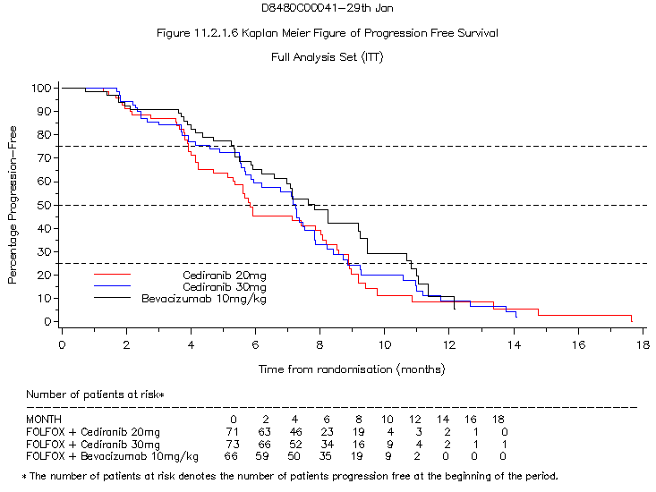
PFS data from 2nd line PII trial available Jan08
 | HR [95% C.I.] | P-value (2-sided)
20mg vs Bev. | 1.28 (0.85,1.95) | 0.29
30mg vs Bev. | 1.17 (0.77,1.76) | 0.79
HR <1 favour Cediranib (adjusted for PS, albumin, ALP)
Some baseline imbalances in pre-defined covariates, KM Curves unadjusted & visually over-estimates the differences
Cunningham D et al. ASCO 2008 abstract 4028

Slide 19
EOPII Decision Grid made more stringent
2nd line PII PFS HR(ced:bev) | RR diff. (ced. – bev.) in PII part of Adaptive trial
 | ≤-10% | >-10% to <-5% | ≥-5% to <0% | ≥0% to ≤10% | >10%
>1.05 | NO GO# | NO GO# | NO GO# | NO GO# | Is pbo HR < 0.8?
≥1 - ≤1.05 | NO GO# | NO GO# | Apply pbo criteria* | Apply pbo criteria* | GO
≥0.95 - <1 | Apply pbo criteria* | Apply pbo criteria* | GO | GO | GO
≥ 0.83- <0.95 | Apply pbo criteria* | GO | GO | GO | GO
<0.83 | GO | GO | GO | GO | GO
Only GO if PFS HR from the first 270 patients recruited
into the placebo controlled trial is <0.8
# all committed HORIZON EOP II data unblinded to AZ.

Slide 20
Well, what happened?
IDMC reviewed unblinded efficacy and tolerability data from patients randomised into PII stage of the PIII trials in Feb08
IVRS vendor sent random scheme directly to Independent Statistician
IDMC met in closed session and answered Yes/No for a series of pre-defined questions to project statistician and medic.
20mg passed thresholds for all revised criteria
30mg did not
Answers relayed to R&D board who gave go ahead, 2 working days later, to continue trial
IVRS switched to new randomisation within 1 week.

Slide 21
So who knew what?
 | IDMC | AZ* | Investigators | Investors
Unblinded data
Analysis results
EOPII criteria
√
X
X
X
√
X
X
X
√
√
X
X
*Restricted to a small, core team

Slide 22
Press release to investment community – Feb08
‘The HORIZON Independent Data Monitoring Committee (IDMC) conducted a planned end of Phase II (EOP II) review of efficacy and tolerability data from the HORIZON programme……. the IDMC confirmed the HORIZON programme could continue and had met pre-defined EOP II criteria.’
‘Due to the Phase II/III trial design, …. is able to move directly into Phase III utilising all the Phase II data and this saves valuable time in assessing the potential benefit of cediranib’

Slide 23
Final PFS data from Adaptive PIII trial
100
mFOLFOX6 + cediranib
90
mFOLFOX6 + bevacizumab
Median PFS
Cediranib 9.9 m
Bevacizumab 10.3 m
HR = 1.10
P = 0.1190 (2-sided)
80
70
60
Patients event-free (%)
Non inferiority assessment:
95% CI 0.97–1.25: required boundary <1.2
50
40
30
20
9.9 m
10.3 m
10
0
0
3
6
9
12
15
18
21
24
Time from randomization (months)
Number of patients at risk*
mFOLFOX6 + ced
709
591
454
296
132
59
22
10
7
mFOLFOX6 + bev
713
601
472
319
140
64
22
12
4
Schmoll H et al - Annals of Oncology 21 (Supplement 8): viii189–viii224, 2010 abstract 5800

Slide 24
Comparison of tolerability profile – relevant for non-inferiority assessment Grade 3/4 AE >5%
 | Cediranib n=705 | Bevacizumab n=704
Neutropenia | 31.8% | 23.6%
Diarrhoea | 13.8% | 5.8%
Fatigue | 7.8% | 4.8%
Peripheral neuropathy | 7.2% | 9.7%
Hypertension | 7.0% | 4.1%
Peripheral sensory neuropathy | 5.8% | 5.3%
Schmoll H et al - Annals of Oncology 21 (Supplement 8): viii189–viii224, 2010 abstract 5800

Slide 25
PFS benefit demonstrated vs placebo However the OS improvement was not statistically significant
1.0
0.9
Cediranib 20 mg (n=502)
0.8
Placebo (n=358)
0.7
0.6
Cediranib 20 mg versus placebo:
HR (95% CI) = 0.84 (0.73, 0.98)
P-value = 0.0121
Probability of progression-free survival
0.5
0.4
0.3
HR <1 favours cediranib
0.2
0.1
0.0
0
3
6
9
12
15
18
21
24
27
30
33
Time from randomisation (months)
Hoff PM et al, Ann Oncol 2010;21:viii9, LBA19

Slide 26
What did we learn?

Slide 27
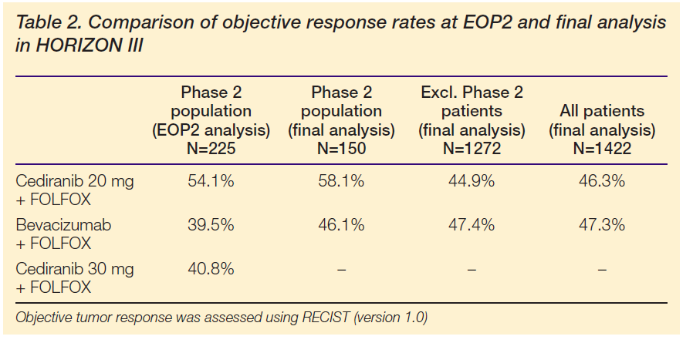
The advantage in Response Rate* seen at the EOPII was not replicated at trial completion
* Response if tumour burden
Wilson D et al ASCO 2011 abstract no. 3633

Slide 28
Should we expect the effect to shrink – even after a randomised, d-blind PII?
Prior distribution of likely
true treatment effects
100 random observed effects
PII (50 events), PIII (500 events)
Outcomes for PII selected
treatments HR < 0.6

Slide 29
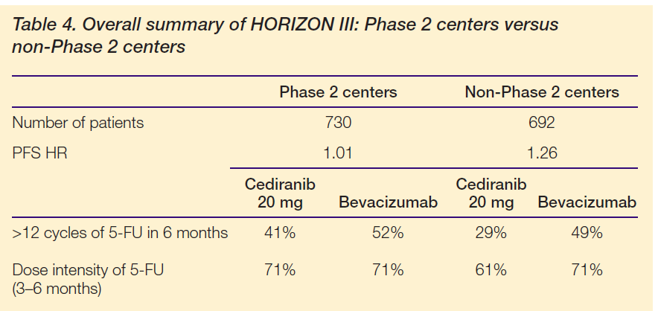
Ability to adapt more limited in adaptive trials!! Some evidence that PIII investigators, with less patient experience were not as successful at managing tolerability Cannot amend protocol to learn from toxicity management
Wilson D et al ASCO 2011 abstract no. 3633

Slide 30
What we learnt on seamless PII/III adaptive designs
What views haven’t changed
Operationally complex
Can be very efficient but more costly than traditional PII then PIII
Will still be selective about use of adaptive designs
Could be of greater value when already know more about the drug
Learning
You are able to adapt less than a non-adaptive program
Use what you learn in PII to adapt PIII e.g. in terms of management of toxicity
Expect treatment effect to shrink between PII and PIII
Applies to traditional development programmes too
Seamless PII/III may still be adopted at AZ BUT
Preferred approach to unblind and replace patients at EOPII so can learn and then adapt

