Slide 1

Who benefits?
Andrew Stone B&I TA Head Oncology
AstraZeneca
E: andrew@stonebiostatistics.com
T: +44 (0) 7919 211836
W: www.stonebiostatistics.com

Slide 2


Statistical QI
How many groups do I need to divide my dataset into before being odds-on of showing an effect reversal?
Only 6
  If the treatment effect is identical per group and equal to the hypothesised treatment effect H1. Oh, and assuming equal n per group & trial has 80% power
Senn, Statistical Issues in drug development
Notes:
See Senn page 205
Interaction power
Main effect variance = 2sigmasq/n (n = total no. per arm)
Interaction variance = 8sigmasq/n as add variance of trt effect within each subgroup which =4/n as number per subgroup is half total
N proportoinal to variance

Slide 3

Statistical QI
If instead of powering for a 10 unit treatment effect , I powered for 10 unit difference in treatment effect between males and females, how much bigger is the trial?
4
  Assuming 50% were male
Byar, SIM, 1985, 255-63
Notes:
See Senn page 205
Interaction power
Main effect variance = 2sigmasq/n (n = total no. per arm)
Interaction variance = 8sigmasq/n as add variance of trt effect within each subgroup which =4/n as number per subgroup is half total
N proportoinal to variance

Slide 4

Subgroups – what we can be certain of!
I told you so!
Oh I didn’t tell anyone beforehand

Slide 5
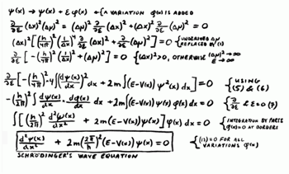

We have a serious false+ve problem
We have a serious false-ve problem
But why would all patients have the same benefit and risk ??

Slide 6

Pharmaceutical Industry & AZ focus on stratified medicine
Pharma companies active in stratified medicine
AstraZeneca: aiming to be an industry-leading capability
Five PHC drugs, 9 companion diagnostics approved in 2013
    >75% Oncology drug approvals
AstraZeneca products following a PHC approach
80% AZ products following PHC approach
    Every phase and therapy area
Building evidence that adoption of PHC increases product and business success¹
2003
2005
2007
2009
2011
2013
Ranked in the top 5 companies²
Moving further and faster
1. Personalized Medicine: The Path Forward” McKinsey website, “Personalized healthcare: Reaching the next frontier of medicine”, Bain website, Readiness for Personalized Medicine”, Diaceutics website
2. PharmaTimes April 2011

Slide 7
AZ late-stage oncology pipeline and stratified medicine
Agent | Stratified hypothesis
Lynparza | BRCAm ovarian, breast, pancreatic ATM+ gastric
Selumetinib | KRAS+ NSCLC
Iressa | EGFRM NSCLC
AZD9291 | EGFRM T790M NSCLC
MEDI4736 | PDL+ve NSCLC, H&N
Faslodex | No prior endocrine 1st line Breast
Unstratified Hypotheses or TBD
Caprelsa | Differentiated Thyroid
Tremelimumab | Mesothelioma
MEDI4736+treme | NSCLC, H&N
Cediranib | Ovarian
NSCLC = non-small-cell lung cancer, H&N = Head and neck cancer

Slide 8
How best to learn

Slide 9
A common oversight
Importance of trial design
Prognostic Biomarker identified

Slide 10
A good design - olaparib 2nd line gastric cancer
Disease progression
Follow for Survival
Screening
Determine ATM status
ATM-positive
( n=60)
Randomise 1:1
Olaparib/ Paclitaxel
Placebo/ Paclitaxel
Olaparib/ Paclitaxel
Placebo/ Paclitaxel
ATM-negative
(n=60)
Randomise 1:1
Recruitment to ATM positive arm was closed once 60 ATM positive patients had been randomised.
J Clin Oncol 31, 2013 (suppl; abstr 4013)
Notes:
JAR: ADD DOSES

Slide 11
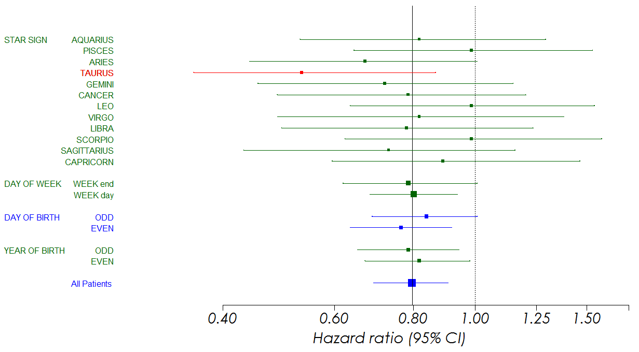
Interpreting the unexpected in Phase II
Is this real??
Taurus star sign!

Slide 12
Creating a structured approach to interpretation
Incorporating strength of prior evidence
Pre-specify how likely there is to be a treatment-by-subgroup interaction of given size
Use a bayesian approach to quantify likely over-estimation of effect*
Extends following basic result for normal data
  Prior ~ N(μ,τ²) , Likelihood ~ N(δ,σ²) - in this case μ = 0 and τ² is pre-specified.
  Posterior
    mean = (σ²/{σ²+τ²}).μ + (τ²/{τ²+σ²}). δ
    Variance = τ²σ²/{σ²+τ²}
*Simon, SIM 2002 2909-16.
Related non-bayesian approach by Senn in Chapter 9 Statistical Issues in Drug Development

Slide 13
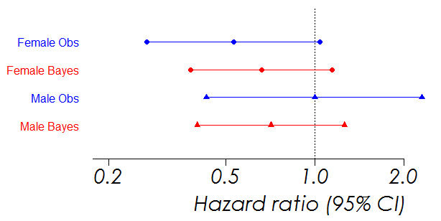
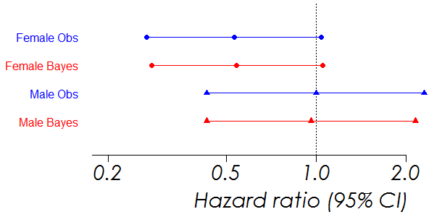
An example – strength of belief reflected in results
Pre-specify chance of interaction
2.5% probability of interaction*
Female bayes = 0.67Female + 0.33male
60% probability of interaction*
Female bayes = 0.96Female + 0.04male
* Probability HRfem/HRmale =0.67
Do not interpret literally but use to give a guide of likely effect shrinkage
  Based on conversation had prior to unblinding
Advanced Analytics Centre (AAC) investigating more sophisticated methods to cover >1 subgroup

Slide 14
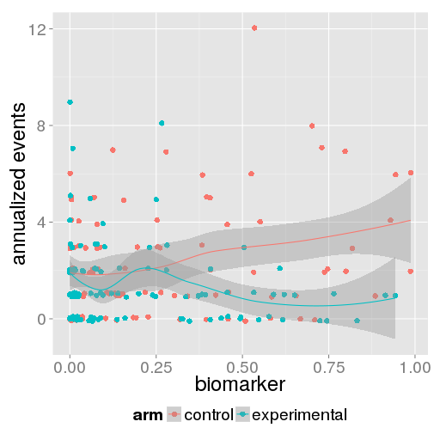
What if predictive biomarker continuous?
Statistical modelling* to optimise cut-off in PII
One example approach
Annual number of hospitalizations as a function of baseline biomarker.
Is there enhanced benefit for patients with biomarker > x?
If so, what is x?
How consistent are our data with pre-existing science?
Influence PIII design
*Paul Metcalfe, Advanced Analytics Centre, AZ

Slide 15
Confirming benefit
Normally uncertainty left

Slide 16
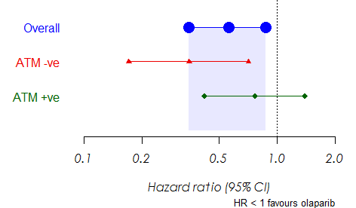
Olaparib gastric design
Co-primary endpoints given PII findings
Phase II data
J Clin Oncol 31, 2013 (suppl; abstr 4013)
Phase III design
α split between ATM-ve subgroup and all patients
Olaparib +
paclitaxel
OS
Randomise 1:1
Double blind
N=500 pts
Placebo +
paclitaxel
C.T. Gov: NCT01924533

Slide 17
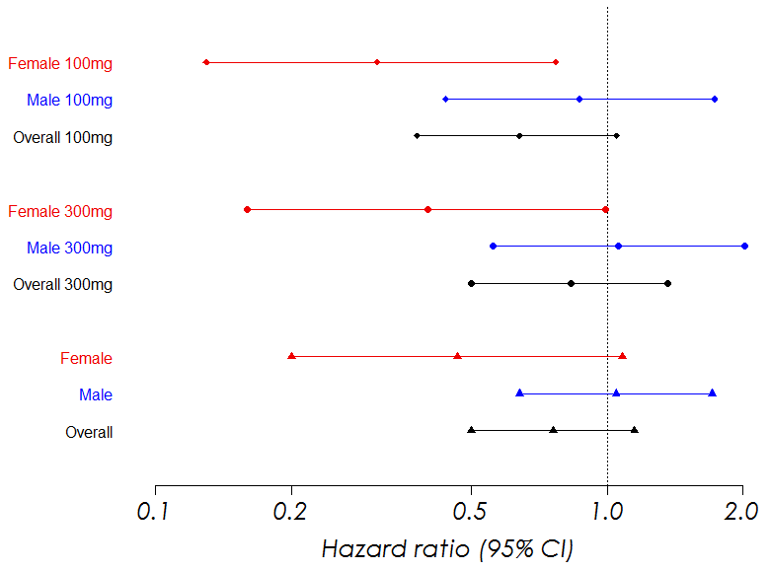
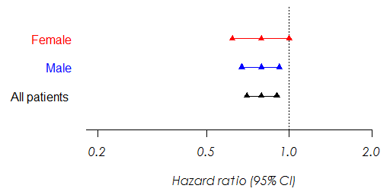
Best to spread bets – vandetanib NSCLC
Gender-by-trt interaction replicated in PII
No clear scientific rationale
Trial 006
Trial 007
J Clin Oncol 25:4270-4277. 2007
J Clin Oncol 26:5407-5415. 2008
PIII interaction disappears but α reserved for overall test
Notes:
Study 6
Overall results
For V100doc versus docetaxel alone,
the estimated hazard ratio was 0.64 (P .037 [one-sided] and .074
[two-sided]; 95% CI, 0.38 to 1.05). For V300doc versus docetaxel
alone, the estimated hazard ratio was 0.83 (P.231 [one-sided] and
.461 [two-sided]; 95% CI, 0.50 to 1.36).
Study 7
Overall
Hazard Ratio = 0.76 95% C.I. = (0.50 to 1.15)
Male
Hazard Ratio = 1.046 95% C.I. = (0.64 to 1.71)
Female
Hazard Ratio = 0.466 95% C.I. = (0.20 to 1.08)
Refs
Heymach 2007, JCO, VOLUME 25 NUMBER 27 SEPTEMBER 20 2007
Hetmach 2008, JCO VOLUME 26 NUMBER 33 NOVEMBER 20 2008

Slide 18
One pivotal trial to define subgroup population for the other
Hypothesised from prior PII data
2015 |  |  |  | 2016 |  |  |  | 2017
1Q | 2Q | 3Q | 4Q | 1Q | 2Q | 3Q | 4Q | 1Q | 2Q | 3Q | 4Q
FLAURA PFS
PIII Study1
Amend SAP and alpha spending
in Study2 if evidence
of predictive subgroup
from Study 1
PIII Study2

Slide 19
Learn and confirm?

Slide 20

Adaptive signature design
Learn and confirm within the same design
All patients and follow-up
included in overall test
at α₁
Subgroup hypotheses
tested amongst n2 patients
at α₂
α₁+ α₂ = α
n₁+n₂
n₁
T
time
Subgroups
explored amongst first n₁ patients
followed to T
Freidlin & Simon, Clin Cancer Res 2005;11(21) 2005

Slide 21
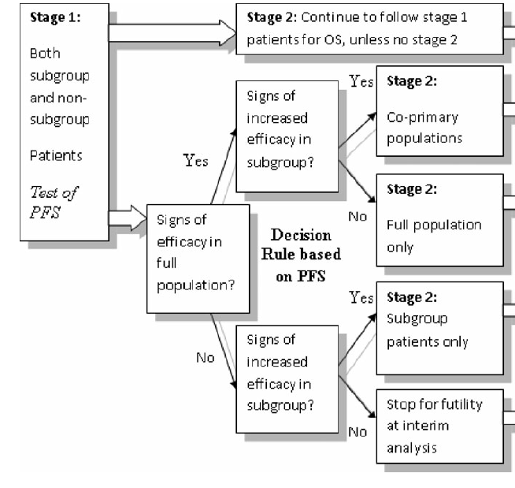
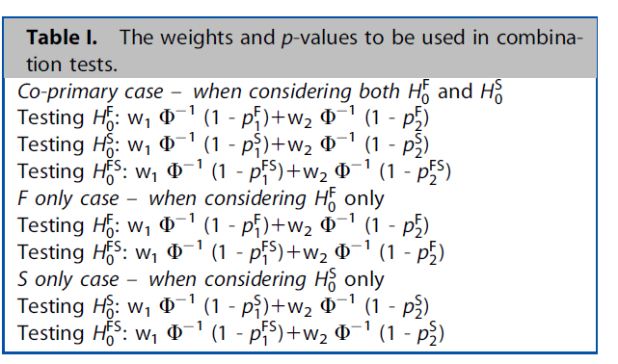
Adaptive sub-population design
Pre-defined hypothesis available
Flexibly define Stage 2 popn = overall, subgroup or both - or stop for futility
Jenkins M, Stone A, Jennison C. Pharm. Statistics 2011 4 347-356

Slide 22
Re-learning
The licensing decision

Slide 23
What happens in the licensing decision
Is the trial +ve – in either full or subgroup?
Yes
Conclude there is a group of patients where the drug is active
Further subgroup analyses performed
Indication is data driven, in context of +ve trial, and pop^{n} may not match either pre-defined pop^{n}
Therefore do not need to be absolutely perfect in definition of subgroup in PII or use to-be-marketed diagnostic (samples stored)
Need to do well enough to increase the chance of +ve trial and data will determine indication

Slide 24
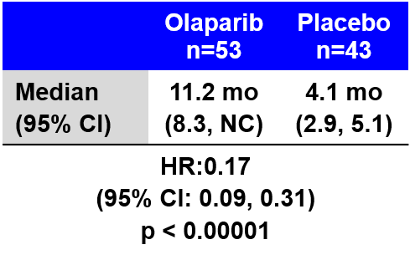
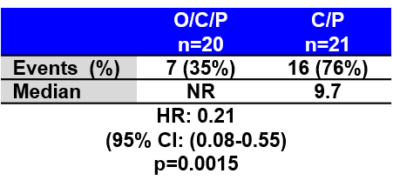
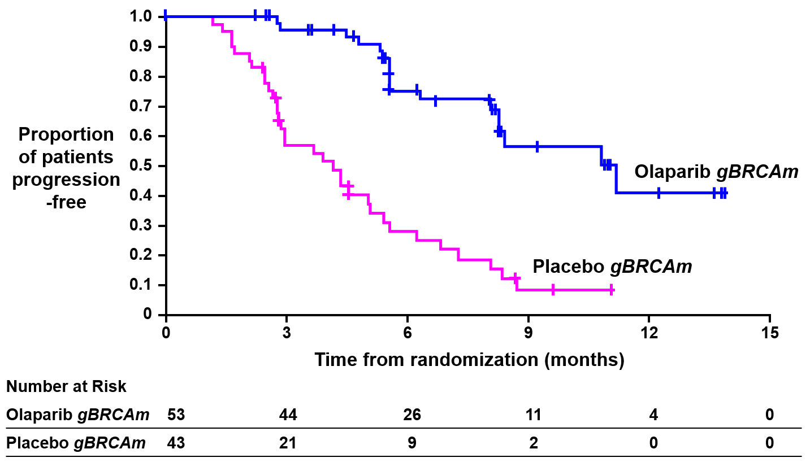
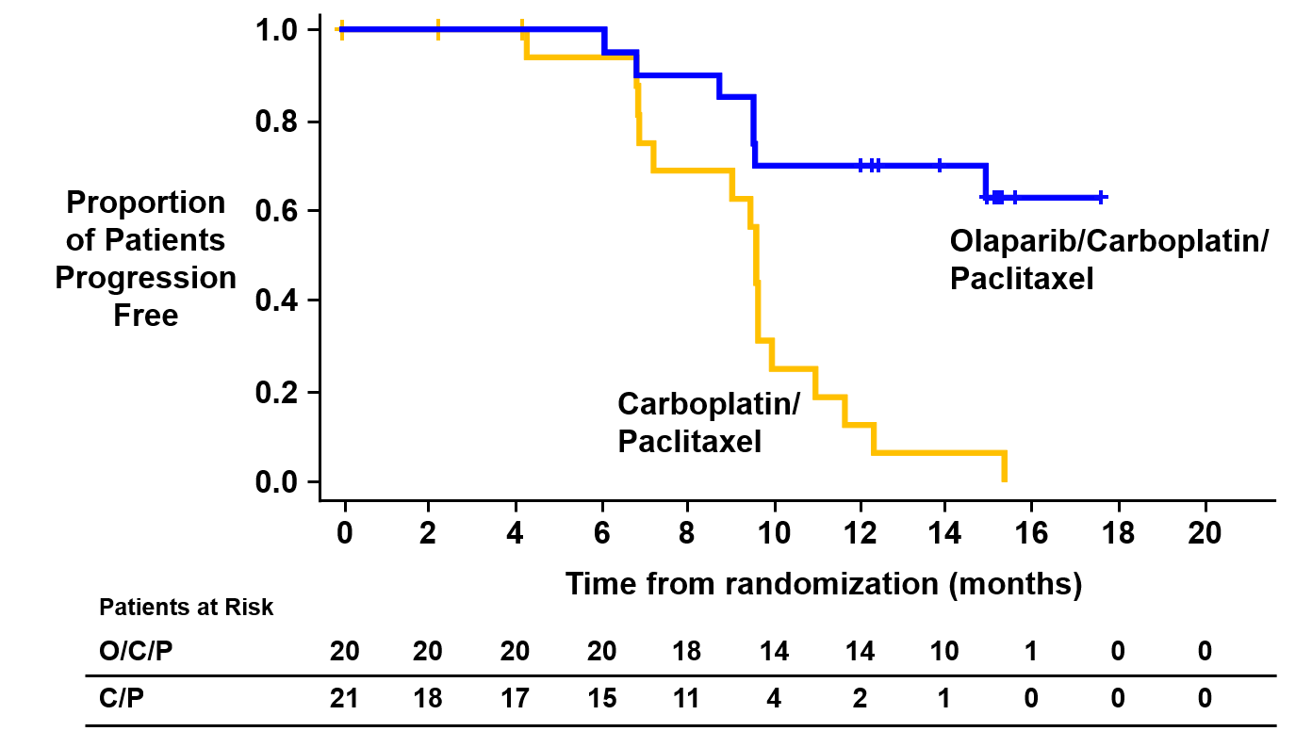
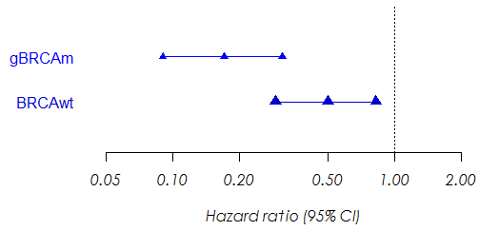
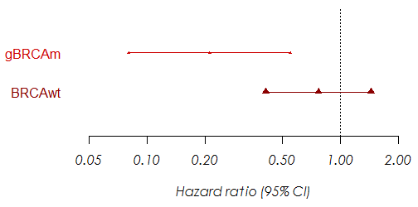
Science, replication and pre-specification
Olaparib BRCA+ve ovarian cancer
Study 19
Study 41
Interaction p=0.03
Interaction p=0.01
The Lancet Oncology , Volume 15 , Issue 8 , 852 – 861, 2014
The Lancet Oncology , Volume 16 , Issue 1 , 87 – 97, 2015
http://www.fda.gov/downloads/AdvisoryCommittees/CommitteesMeetingMaterials/Drugs/OncologicDrugsAdvisoryCommittee/UCM402209.pdf

Slide 25
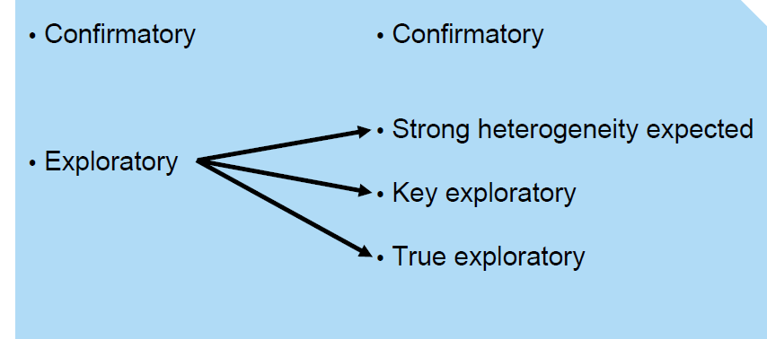
Advice from Rob Hemmings (MHRA)
‘Important, Infuriating and Intractable’

Slide 26
What are AZ doing?
Stratified medicine pursued in many programmes
AAC Development of sophisticated approaches to assessing subgroups
    Bayesian subgroup approaches
    Missing biomarker using multiple imputation
    Structured exploration
Work on novel designs
    Including situations where population defined in response to therapy*
Carefully consider our approach in SAPs
Work closely with regulators to prescribe our products to the right patients
* Can a treatment be licensed on the basis of post treatment predictive biomarkers?
Stone A, Schmitt N. Pharmaceutical Statistics 2014 13 214-221.

Slide 27
Conclusions
Statistician has a key role to play
  Technical
  Influence
Continued area of active research
So we can better serve patients

