Slide 1
Non-Proportional Hazards – So What?
E: andrew@stonebiostatistics.com
T: +44 (0) 7919 211836
W: www.stonebiostatistics.com
Andrew Stone
BBS spring seminar April 28th 2016

Slide 2
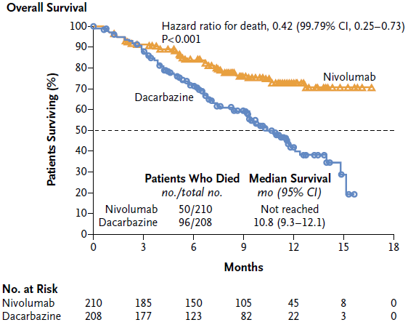
Justifiably huge excitement about a new class of agents
As predicted by biology, one of the earliest results suggested a delayed effect
This raised fundamental questions about the design and analysis of data from this class, especially for situations where the treatment effect was not so large
C Robert et al. N Engl J Med
2015;372:320-330.

Slide 3
One fundamental question: is the hazard ratio (HR) interpretable in the presence of non-proportional hazards (NPH)?
Influential publication*
‘When the PH assumption is violated (ie, the true hazard ratio is
changing over time), the parameter actually being estimated by the
Cox procedure may not be a meaningful measure of the between group difference; it is not, for example, simply an average of the true hazard ratio over time.’6
Really?? Let’s examine this assertion.
* Uno H, J Clin Oncology 2014 2380-5

Slide 4
Is this any different to multicentre clinical trials?
Quantitative treatment-by-centre interaction
We’re quite happy to describe the treatment benefit as the average over centres even if there is statistical evidence that the benefit differs across centres
NPH = quantitative treatment-by-trial interaction
Acknowledge, but describe overall benefit as the average treatment effect over time
Likely with a large enough trial there would always be evidence of NPH
But how do we estimate the average HR?

Slide 5
The HR estimated from a standard cox/log-rank is the average HR – with all events weighted equally
Time Period | Hazard rate |  | HR
 | New | Control
0-3 | 0.1 | 0.2 | 0.5
3-6 | 0.3 | 0.2 | 1.5
HR estimated by Cox |  |  | 0.86
Weighted average of piecewise HR |  |  | 0.86
HR = geometric mean of piecewise HRs, weighted proportional to no. of events per period
where p₁ and p₂ are proportion of events per period
Noting that all patients, with events, are treated as equally important in terms of increasing life

Slide 6
For future reference: why.
ln(HR) ~ U/V*,
where U = the usual log-rank denominator
and V = ~e/4 the usual log-rank numerator which is
equal to the reciprocal of the variance for the ln(HR) with e the total of events
U and V can be partitioned into summations before and after a change in HR
and noting that the above implies U~ (e/4) . ln(HR)
Therefore the overall lnHR
=(U₁+U₂)/(V₁+V₂)
= ( e₁/4 . ln(HR₁) + e₂/4.ln(HR₂) ) / (e₁/4 + e₂/4 )
= p₁ ln(HR₁) + p2 ln(HR₂)
* Berry G, Kitchin RM, Mock PA. A comparison of two simple hazard ratio estimators based on the logrank test. Statistics in Medicine 1991; 10:749-755
Sellke, T. and Siegmund, D. Sequential analysis of the proportional hazards model. Biometrika 70: 315-326, 1983

Slide 7
Ah but...
Cox ‘assumes’ proportional hazards
Assumes an unfortunate word as implies, with lack of PH, the test is somehow not valid
‘Assume’ actually means ‘most powerful’ when the alternative is NPH
Under H0 by definition we have PH anyway
Incidentally, many times I’ve heard it stated, incorrectly, the log-rank (LR) doesn’t assume PH as makes less ‘assumptions’ as it’s fully non-parametric
Cox and LR will always give results very close
Can be made to be identical if both based on a score test, use same method to handle ties and stratified by the same factors
But should acknowledge in interpretation that with further follow-up that treatment effect will change
Importance of follow-up
This applies equally to the alternatives proposed

Slide 8
However, regardless of proportionality .......
HR=0.5
Median = 5
Mean = 7.2
HR=0.5
Median = 2.1
Mean = 2.2
Exponential distn
Control median = 5
Weibull distn S(t) = exp(-0.028*t²)
Control median = 5
Same meaning clinically?
We need to supplement with absolute benefit
NOTE: A kaplan-meier of the ranks looks identical for both distibutions, as HR based on relative ranking not actual times

Slide 9
HR remains meaningful and the primary measure of effect But supplemental measures needed But what?

Slide 10
Medians normally used for absolute benefit, yet we know they’re a lousy measure
Medians
What happens afterwards has no bearing
For PFS in particular: random steps on KM curve and dependence on timing of scans for PFS
So what are the alternatives?

Slide 11
‘Landmark analyses’ – easy to understand but...
Could compare the proportion of patients surviving 1 year
Timepoint pre-specified
Need to use KM estimate and adjust variance accordingly¹
Note ratio of ln(S(t)) = ratio of average hazards, different to average hazard ratio
Very easy for clinicians and patients to understand
Your chance of surviving for a year is increased by x%
Could be more powerful than HR with NPH
Depends on separation and no. of events after the timepoint
Note if ~PH then always less powerful than HR as less events included²
¹ Klein JP, et al. Analyzing survival curves at a fixed point in time. Stat Med 2007;26:4505-4519.
² Stone A et al. Improving the design of Phase II trials of cytostatic anti-cancer agents. Cont Clin Trials 2007 28: 138-145

Slide 12
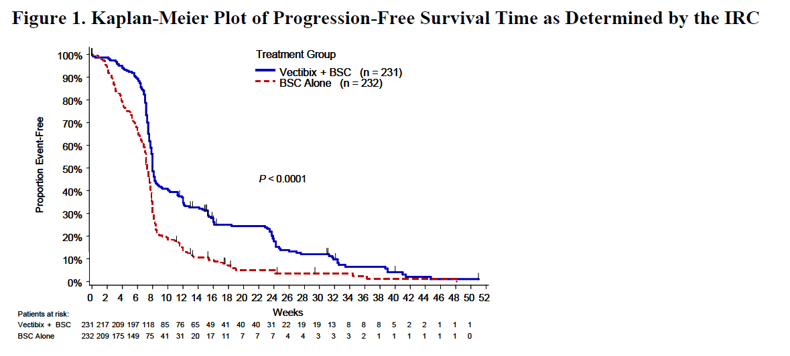
What about mean survival
Easy to understand
Standardly used with continuous data
Same as AUC of KM curve
But....
Requires a high proportion of events (ie high maturity and little censoring)
Could be unduly influenced by a few events
As a requirement therefore would delay access to medicines
Precedent for using in labelling
Panitumumab
‘The mean PFS was 96 days in the Vectibix arm and 60 days in the BSC-alone arm.’

Slide 13
Restricted Mean gaining popularity
Suggested by authors at the Medical Research Council, UK¹
Idea to restrict inference to period with PH
Calculate mean during that period, adjusting for censoring
Hard concept to convey
If you progress within 2 years you’ll progress 3 months later on average
‘Some evidence of non-proportional
hazards was noted (p=0·06) and the restricted mean survival time over 2 years was 12·5 months (11·7–13·4) in arm C and 9·4 months (8·6–10·2) in arm A.’²
¹ Royston and Parmar BMC Medical Research Methodology 2013, 13:152
² Ledermann et el.. Lancet Vol 387 March 12, 2016

Slide 14
Mean restricted regardless of period of proportionality
Estimated from curves:
RMST difference with truncation point at 12 months ~1.5
RMST difference with truncation point at 18 months ~ 2.4
Presented By David Spigel at 2015 ASCO Annual Meeting; RMST calculated by digitization of curves

Slide 15
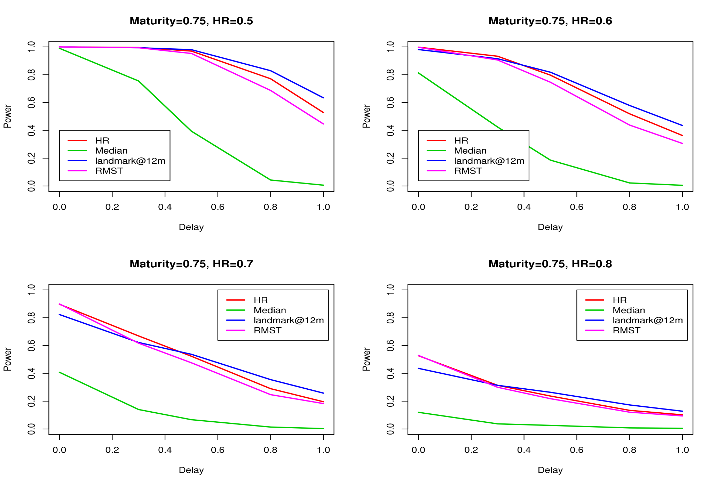
Properties of RMST – subject of study at AZ
HR and RMST similar power, expected as HR ~ relative AUC of KM of ranks?
Simulations by Luping Zhao

Slide 16
Can we make better use of parametric approaches?
With PH
The Event Time Ratio (ETR¹) could be estimated from a weibull accelerated failure time model
where each arm has the same shape parameter and thus would also have proportional hazards
For all percentiles, the treatment effect is delayed by a common % = ETR
Regardless of proportionality, mean survival times can be expressed as a function of parameters specific to each treatment arm
See Ellis² for means and variances
Advantage: these would represent overall predicted means rather than those restricted to a timeperiod. To be studied further
¹ Carroll KJ Controlled Clinical Trials 24 (2003) 682–701
² Ellis S Contemporary Clinical Trials 29 (2008) 456–465

Slide 17
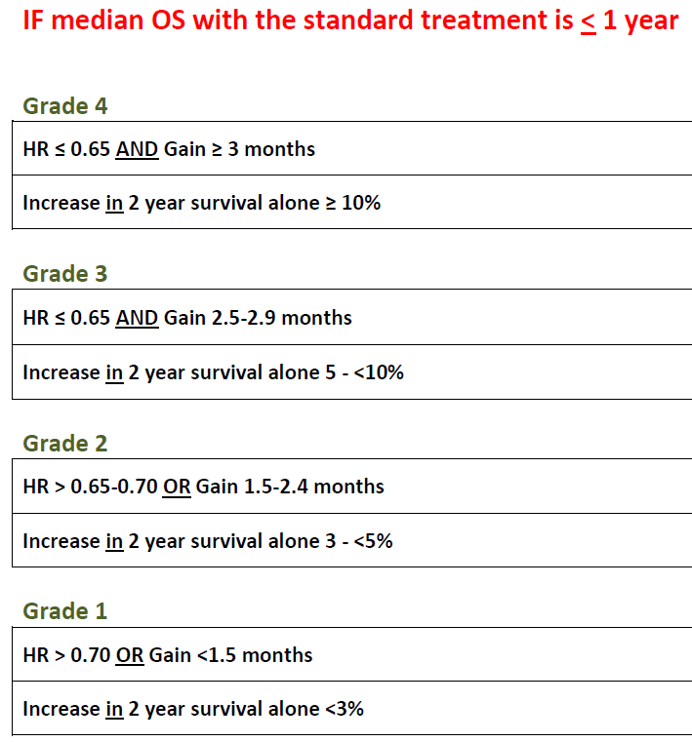
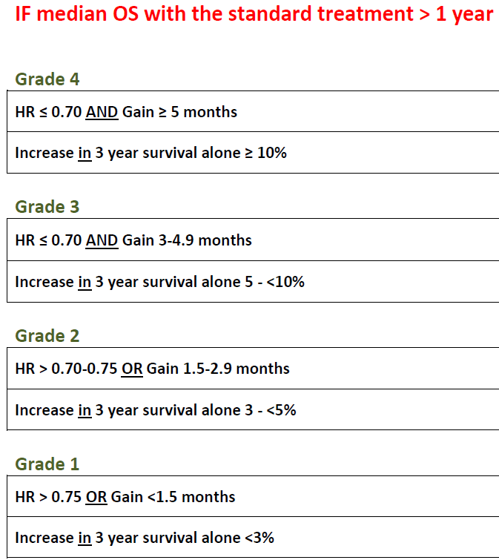
All of this very important: ASCO & ESMO Value Framework:
Scenario: Advanced Disease with OS as Primary
ESMO
Both frameworks also includes grading for toxicity and/or QOL and cost. This presentation focuses on efficacy grading only.

Slide 18
Impact on Trial Design

Slide 19
Sizing with a delayed treatment effect – for future reference
Assume
HR₁=1 𝑡<𝑇, HR₂ =𝑥 (<1) 𝑡≥𝑇,
where T denotes the lag-time until there is a benefit of therapy and HR₂ the hazard ratio (experimental : control) before and after the lag respectively.
The overall average HR is given by ^{1,2}:
Where p₂ is the proportion of events observed before and after the lag-time respectively.
Therefore power will increase as p₂ increases
Then assume patients are recruited according to³: k=2 often approximates reality well
For a given follow-up:
can then be calculated and together with n, the total no. of events, the following can be re-arranged to estimate power
Where r= randomisation ratio (eg r=1 with 1:1 randomisation)
¹ Kalbfleisch, J. D., and Prentice, R. L. (1981), “Estimation of the Average Hazard Ratio”, Biometrika, 68, 105-112.
² Schemper, M. (1992), “Cox Analysis of Survival Data with Non-Proportional Hazard Functions”, The Statistician, 41, 455-465.
³ Carroll KJ (2009), Pharmaceutical Statistics, 8, 333–345. A closed form solution is presented with T=0, exponential and integer k

Slide 20
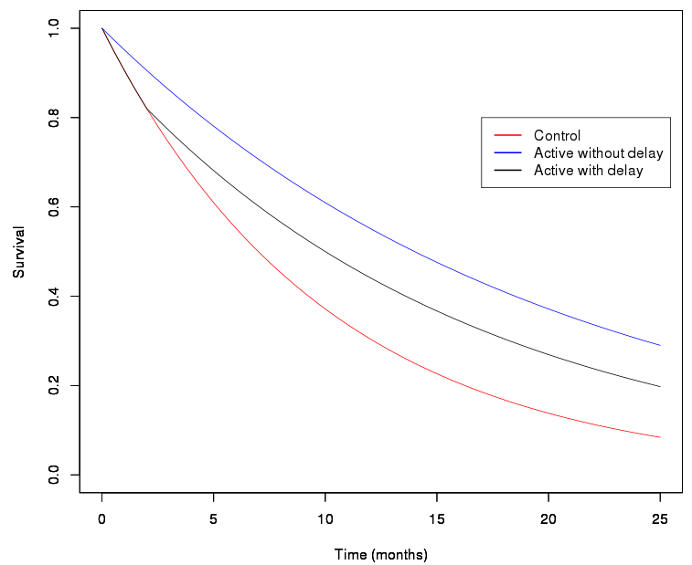
Example survival curves with T=0 and 2
HR=0.5 without delayed separation
HR=1 before
separation
HR=0.5 after separation

Slide 21
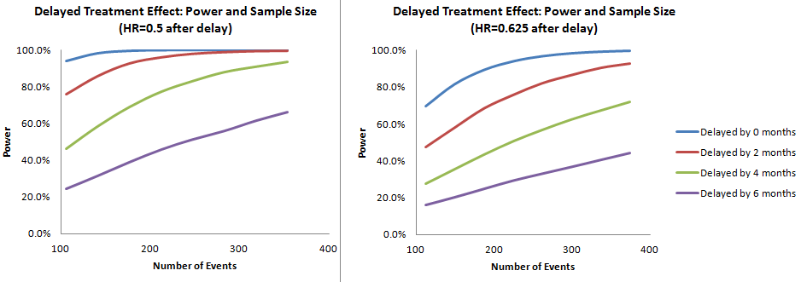
Adverse impact on power if delay is not accounted for
1:1 randomization; assumes e/0.71 patients are recruited where e = no. of events
Fixed 15 months accrual time (uniform);
Median OS (control)=7 months; 2-sided type I error =0.05;
Simulations by Wenmei Huang

Slide 22
Unlike PH, power dependent on maturity
With NPH power increases as proportion of events that occur after time-lag increases
PH - H1: HR=0.6
NPH – H1: HR=1 for t≤4, HR=0.4 for t>4
In this case, power coincides when trials have ~50% maturity e.g. 320 patients

Slide 23
An alternative approach to futility analyses maybe needed
For example, final analysis to be conducted with 194 events out of 274 patients (71% maturity) ¹
If the futility analysis² is planned after 97 events, then either this analysis could be performed
After the first 97 events occur
Alternatively, only including, and after the first 97 events have occurred amongst the first 137 patients recruited (71% maturity same as final analysis)
If T, the lag-time =2, then the probability of false negative is
11% for option a)
5% for option b)
¹ Median OS in the control arm of 7 months , 1:1 randomization; uniform accrual of 30 patients per month; target HR of 0.625; T=0 ;.
² Total events adjusted to 194 events with LanDeMets OBF beta ,10%, spending. Futility if interim HR> 0.948

Slide 24
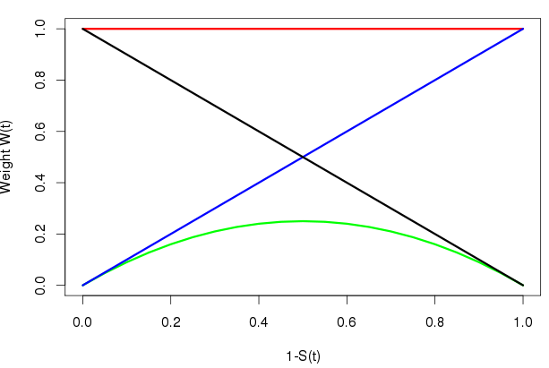
Log-rank test – can we do better?
The log-rank test weights each event equally
There exist alternatives with different weight per event
One alternative is to use the G^{ρ,τ} class¹ of weighted log-rank tests
Where:
ρ=0, τ=0 corresponds to the log-rank
ρ=0, τ=1, weights proportionately to (1-S(t)), estimated from KM, hence more weight to later events
____ Log Rank
____ Fleming-Harrington’s (1,1)
____ Fleming-Harrington’s (0,1)
____ Fleming-Harrington’s (1,0)
¹ Fleming, T.R., and Harrington, D.P. (1991), Counting Processes and Survival Analysis, John Wiley & Sons, New York.

Slide 25
Yes
 | Power
 | Under H0 | T=0 | T=2 | T=4 | T=6
Log-rank | 4.8 | 89.9 | 67.5 | 43.3 | 23.5
G^{0,1} | 5.5 | 79.4 | 74.7 | 60.5 | 41.2
G^{1,1} | 4.9 | 85.9 | 78.1 | 55.2 | 29.8
G^{1,0} | 5.4 | 85.8 | 50.9 | 24.5 | 12.1
5000 simulations with:193 events from 266 patients, HR follows (1) with x = 0.625 for different T (=0, 2, 4 and 6-month, respectively), 15 month accrual, median OS=7, 2-sided α=5%
Simulations by Wenmei Huang

Slide 26
But should we??
The use of unequal weights implies increasing survival is more important for some patients than others
That’s OK if we can identify those patients before they’re dosed
But if not, why would it be more important to increase survival of those patients who have the better prognosis?
However, if there was evidence of a cure:
If no evidence of harm to any patients, the overall population may have a +ve B/R if no overall average effect but an important proportion of patients were cured

Slide 27
How well do cure rate models work?
Parametric mixture models investigated
p =proportion cured and weibull survival in non-cured
Long term cured model derived based on nivolumab melanoma data
Two questions investigated
How do you know whether you’ve correctly identified the cure rate?
How much follow-up do you need?

Slide 28
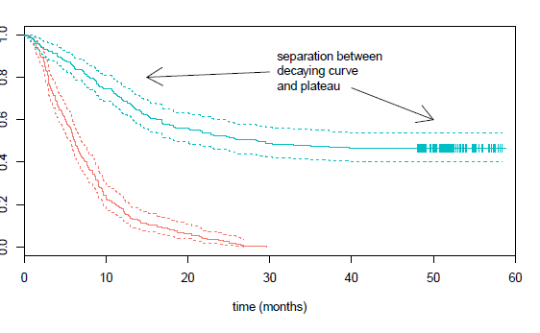
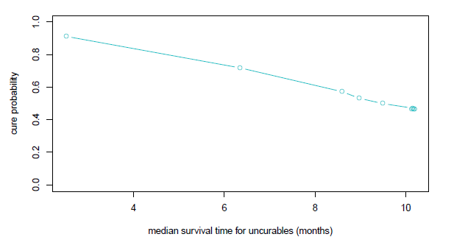
Models will always provide an estimated cure fraction. But not necessarily the correct one!
True curve simulated from
Cure fraction badly over-estimates truth if analysed too early
95% CI excludes truth (not shown)
To the extent that lower CI for cure fraction excludes the truth
Simulations by Monika Huhn & Paul Metcalfe

Slide 29
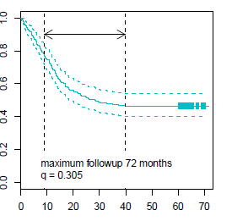
How long should we follow patients until we can be confident of estimated cure rate?
First of all would require a cause-specific survival analysis
Censoring non-cancer deaths
One possibility, proportion of uncensored observations with an event in the interval [t* - (t-t*), t*], where t* = latest event (uncensored) time, t = largest time (event or censored).
An aside: q uses a denominator of the total no. of observations
Whereas if the denominator was the number of uncensored
Observations would have better properties
max value =1 independent of cure rate

Slide 30
Just finally – what’s the emerging picture in terms of presence of delayed effect?

Slide 31
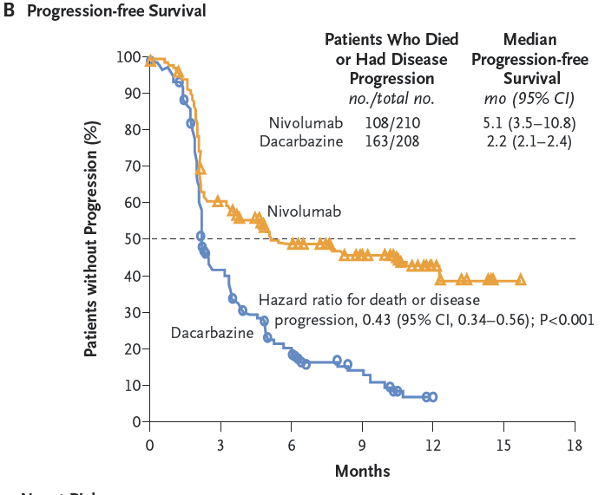
Careful how PFS curves are (mis?) interpreted
Care required when examining presence of time-lag with PFS data
Have seen KM curves misinterpreted a few times
In the example opposite:
At the first scheduled scan, 9 weeks, there is a clear difference in proportion progressing
The few earlier events will be either
deaths in absence of progression
unscheduled scans, probably prompted by deterioration in symptoms
In this case, effect on PFS was immediate

Slide 32
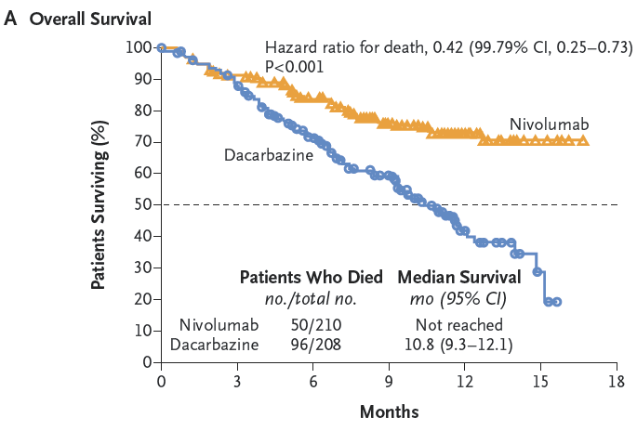
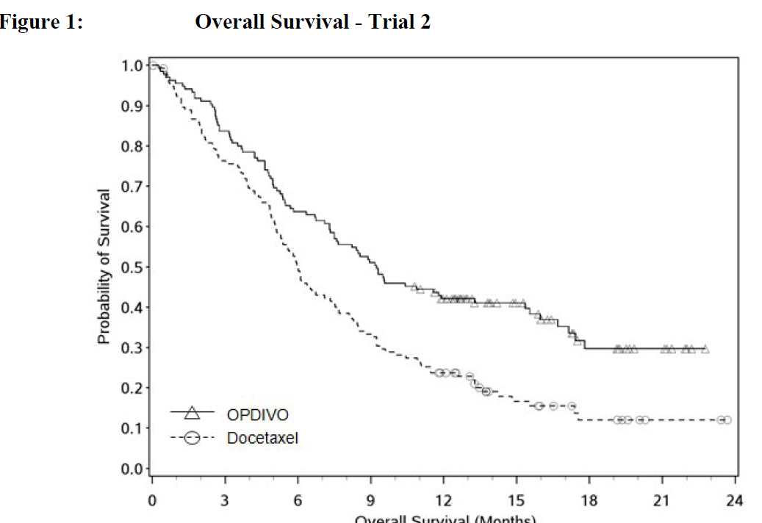
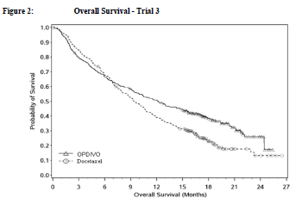
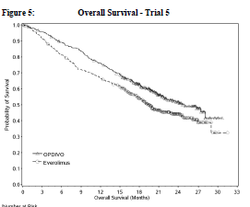
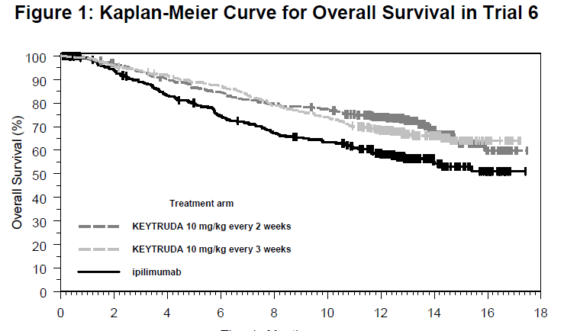
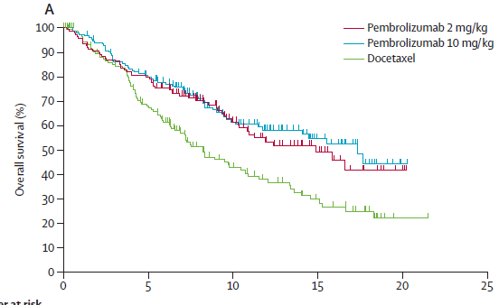
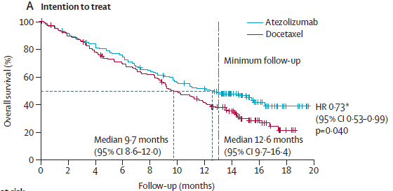
Emerging OS data generally support delayed effect
Nivo - melanoma
Nivo – NSCLC Sq
Nivo – NSCLC NSq
Nivo – renal
Pembro – Melanoma
Pembro – NSCLC
Atezol – NSCLC

Slide 33
Non-Proportional Hazards – So What?
The hazard ratio remains a suitable, primary measure of average effect
However
The clinical data support presence of delayed effect
Need supplemental (not replacement) measures of average absolute benefit
Ones that include all the data recorded from patients
Important implications for design
Demonstration of cure would be a game-changer
Associated statistical challenges
The excitement about the class is justified

